Slide 1
Marzano’s Principles
Making Central Florida’s Schools Successful
Hannah Gordon
(hannah_gordon@knights.ucf.edu)
Sharon Woods
(sharon.woods@knights.ucf.edu)
Notes:
“Good morning!”
Introduce ourselves
Explain what we see in internship regarding observations
Ask “How many of you have heard of Dr. Robert Marzano?”
Transition to next slide – After this session, you should have a better understanding of Marzano, his significance, and his educational concepts.

Slide 2
Who is Dr. Robert Marzano?
A leading researcher in education
He is a speaker, trainer, and author of more than 30 books and 150 articles on a variety of education topics
His books include:
Designing & Teaching Learning Goals & Objectives,
The Highly Engaged Classroom, Formative Assessment & Standards-Based Grading
On Excellence in Teaching
District Leadership That Works
The Art and Science of Teaching
Notes:
Topics of his research, articles, and books include:
Instruction
Assessment
Writing
Implementing standards
Cognition
Effective leadership
School intervention

Slide 3
Why are Marzano’s Principles important to you?
His practical translations of the most current research and theory into classroom strategies are internationally known and widely practiced by both teachers and administrators
These practices have been adopted by both Orange and Seminole County Public Schools and possibly many other counties in Florida
See www.fldoe.org/profdev/pa.asp
Adoption of his principles are part of Race to the Top
Notes:
***OPEN WEBSITE BEFORE PRESENTATION: www.fldoe.org/profdev/pa.asp
Some counties have adopted Charlotte Danielson’s research model. However, most Central Florida counties have adopted Robert Marzano. You can find out which research a county has adopted by going to www.fldoe.org/profdev/pa.asp to view the matrix.
The Race to the Top Fund provides competitive grants to encourage and reward States that are creating the conditions for education innovation and reform.

Slide 4
Marzano’s Domains
Notes:
Marzano’s principles are divided into teaching domains. There are four domains, each containing several design questions for evaluation.
Today we will focus primarily on domain 1, which is the main focus of Orange and Seminole County Public Schools. It is being incorporated gradually throughout this year, with full adoption of all domains occurring in the 2012-2013 school year.

Slide 5
Communicating Learning Goals & Feedback
Design Question 1: What will I do to establish and communicate learning goals, track student progress, and celebrate success?
Notes:
Think about any time you have been in a classroom. Did the teacher provide you expectations for your lessons or assignments?
*Allow wait time.
As a pre-professional teacher, think about a time when you taught a lesson. Did you explicitly state your learning goals to your students?

Slide 6
Setting & Communicating Learning Goals
Teacher provides a clearly stated learning goal.
Students will be able to __________________.
Learning goals are not activity based.
Learning goals state what students will understand or know.
They are not measurable.
They do not include specific activities.
Notes:
For example, our learning goals for today are:
“You will be able to distinguish between learning goals and activities.”
“You will be able to use scales to self evaluate your understanding.”

Slide 7
Notes:
Example: Difference between learning goals and activities
Table is from Marzano’s The Art and Science of Teaching
You will notice the word “understand” is used in learning goals. This is okay! Learning goals are not lesson objectives.

Slide 8
Group Activity 1: Identify Learning Goals vs. Activities
Students will be able to recognize the protagonist, theme, and voice of a piece of literature.
Students will produce a book report on a book of their choice, including a table of contents, with proper pagination and format throughout.
Given a set of coordinates, students will be able to graph the slope of a line.
Notes:
1. Students will be able to recognize the protagonist, theme, and voice of a piece of
literature.
This is a learning goal. There is a desired outcome specified (recognizing the
protagonist, theme, and voice of a piece of literature).
2. Students will produce a book report on a book of their choice, including a table of
contents, with proper pagination and format throughout.
This is primarily an activity. The cognitive or behavioral outcome is not clearly
specified. There is no particular level of understanding or ability that is needed to
produce a book report with these specifications. There are no clear standards for
judging the quality of the product.
3. Given a set of coordinates, students will be able to graph the slope of a line.
T his is a learning goal. There are clearly defined cognitive and psychomotor skills
that students must demonstrate.

Slide 9
Tracking Student Progress
Scales – Student Self Evaluations
Must be highly visible
Must be BIG
Must be appropriate to the grade level
Must be used in a manner in which student’s self evaluation remains anonymous
Notes:
Highly visible: in front of the classroom, on student desks, where administrators/visitors can see
Grade level appropriate: might mean thumbs up, thumbs down for early primary, number scale for intermediate
Student’s self evaluations remain anonymous: heads down, eyes closed, hold fingers up

Slide 10
Student Self Evaluation Scale Third Grade Example

Slide 11
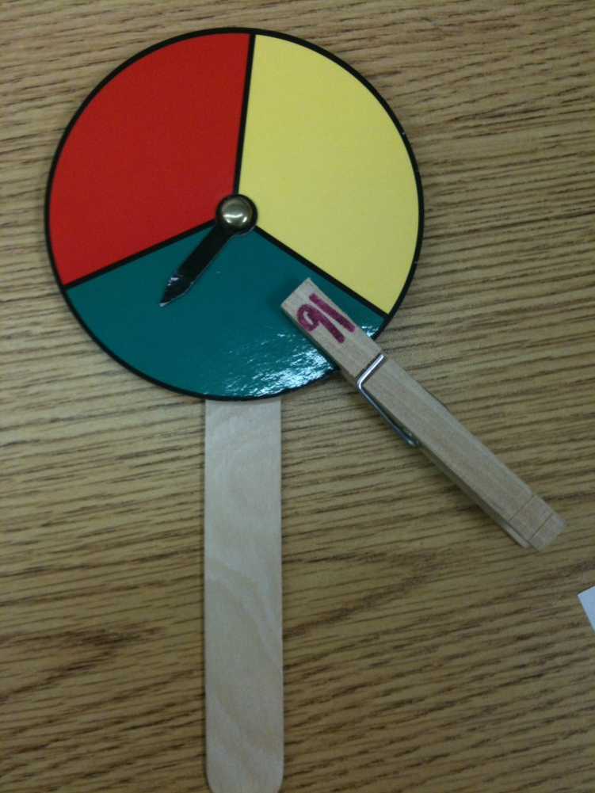
Student Self Evaluation Scale Second Grade Example

Slide 12
Individual Activity 1: Our Student Self Evaluation Scale
Learning Goal: You will be able to distinguish between learning goals and activities.
Learning Goal Scale
4 = I could teach someone the difference between learning goals and activities.
3 = I can distinguish between learning goals and activities on my own.
2 = I can almost distinguish between learning goals and activities on my own.
1 = I am starting to understand the difference between learning goals and activities but I need a little help.
0 = I can’t understand the difference between learning goals and activities without help.
Notes:
Heads down, eyes closed, where do rate yourself now?

Slide 13
Tracking Student Progress
Scales/Rubrics: Teachers Evaluate Students
Students must know what they are being evaluated on
Can be applied to all content area topics
Must incorporate the learning goal
Students must be able to explain how the scale is used
Notes:
Recall a recent assignment in one of your courses. What did your rubric look like for the assignment? Did you know all the requirements of the evaluation?
Providing a scales/rubric is more than handing it out to students. The teacher must present the information on the rubric in a manner in which students are able to explain and describe how the rubric/scale is measuring their ability to complete the learning goal.

Slide 14
Notes:
Example of Rubric/Scale for teacher use
Does not have to look like this one. This is the example in Marzano’s book. The important thing is that a rubric is provided.
It can be generic, but students must have a rubric and explanations for each point value prior to an assignment/assessment.

Slide 15
Group Activity 2
Learning Goal: You will be able to create a scale for a learning goal for a second grade class.
Choose your topic:
LG1: Students will be able to complete two-digit addition with regrouping.
LG2: Students will be able to identify the stages of the water cycle.
Create a rubric for your chosen topic.
Assignment Rubric for Group Activity
3 = The group provides in-depth learning scale over and beyond requirements.
2 = The group exhibits no major errors or omissions when creating the learning scale: 4 levels, title, grade appropriate
1 = With some help, the group was able to demonstrate partial understanding of creating a learning scale.
0 = Even with help, group could not create a scale for the learning goal chosen.
Notes:
Have one group share if there is time.

Slide 16
Celebrating Student Success
Use formative assessment approach so students are able to see their own growth
Students can plot their progress in a personalized folder
Virtually every student will succeed in the sense that each student will increase his or her knowledge to specific learning goals
Intrinsic motivation
Notes:
Formative assessment approach is an ongoing evaluation system.
Students are intrinsically motivated because they become aware that they are responsible for their academic success.
Focusing on knowledge gain also provides a legitimate way to recognize and celebrate – as opposed to reward – success. Focus on getting students away from tangible rewards (prizes, stickers, treasure box) and redirecting them to celebrate individual success. The goal is for students to self-regulate their own success and become intrinsically motivated.

Slide 17
Notes:
Example of student progress chart

Slide 18
Establishing Classroom Routines
Design Question 6: What will I do to establish or maintain classroom rules and procedures?

Slide 19
Classroom Management
Teacher reviews expectations regarding rules and procedures to ensure their effective execution.
Open to alteration
Value student input
More effective teachers spend a great deal of time establishing and reinforcing rules and procedures, whereas first year teachers typically spend little time.
Notes:
Expectations should be reviewed prior to student activities.
This includes monitoring during student-led activities.

Slide 20
Classroom Management
Involves:
Organizing the classroom for effective teaching and learning
Establishing a small set of rules and procedures
Interacting with students about classroom rules and procedures
Periodically review rules and procedures, making changes as necessary
Use classroom meetings
Notes:
The arrangement should provide for flexibility in organizing students. The 21st century classroom includes technology, learning centers, and other equipment that the teacher must consider when designing the classroom. Can the students reach materials? Is student safety a priority?
Teachers in elementary grades should have 5-8 rules and procedures. The teacher should come up with the 3 most important and have the students help create the remainder.
Explain and refer to the rules as necessary.
Should be set up at the beginning of the year and addressed periodically throughout the year. Modify as needed.
Required at least weekly in all schools in Orange and Seminole counties. Should be 10-15 minutes in length. Discuss classroom issues, news, upcoming events, review procedures and rules.

Slide 21
iObservation
What is iObservation and why is it important to you?

Slide 22
Evaluating Teachers
iObservation
The only system featuring frameworks of Dr. Marzano and other researchers to develop teacher and leadership effectiveness
Used in both Orange and Seminole Counties
Administrators do both formal and informal observations and evaluations using an iPad or computer
Notes:
The observation format is broken into Marzano’s domains.

Slide 23
Evaluating Teachers
Teacher evidence the observer will be looking for:
Learning goals posted so students can see them
Learning goals as a clear statement of knowledge
Teacher making reference to the learning goal throughout the lesson
Teacher has a scale or rubric that relates to the learning goal
Students can see the scale or rubric throughout the lesson
Teacher makes reference to the scale or rubric throughout the lesson
Student can identify the learning goal and scale and be able to relate them to the lesson and activities
Student can explain the meaning of the performance goals articulated in the scale
Notes:
These items should be reviewed prior to beginning a lesson and throughout the lesson. Administrators will pull students aside to ask them questions about the learning goal and scale when they enter the classroom.

Slide 24
Group Activity 3: Evaluate Us
Use the teacher evaluation provided to evaluate us on our effectiveness in using:
Learning goals
Scales
Rubrics

Slide 25
References
http://marzanoresearch.com/About/about_dr_marzano.aspx
http://www2.ed.gov/programs/racetothetop/index.html
http://www.scps.k12.fl.us/employees/TeacherEvaluationFeedback.aspx
https://www.ocps.net/es/hr/PDS/assessment/Documents/Evaluation%20Manual%202011%20final%209%2029%2011%20revision%2010-16-11.pdf
Marzano, R. (2007). The art and science of teaching. Alexandria, VA: ASCD.
Notes:
Any questions?
Thank you all for attending our workshop.

